Slide 1
Determining the optimum vaccination schedule for the MMR vaccine
Max Goulding
Wednesday 6th March 2013

Slide 2
1996 – MMR 2nd Dose Introduced
1993 – Selective rubella vaccination ends
1970 - Measles vaccine Selective rubella vaccine
1998 – Wakefield study. Linking MMR with Autism
1988 – MMR introduced
Single Dose

Slide 3
Challenges of MMR in post-vaccine era
Coverage for most recommended vaccinations is 95% in the UK. MMR had 89.1% 1st dose coverage and 84.2% 2nd dose coverage in 2011
Changes to duration of protective maternal immunity since the introduction.
Vaccination derived immunity has been shown to not be lifelong in some cases.

Slide 4
Protective Maternal Immunity
Mother passes on antibodies during pregnancy which protect infant from infection.
Antibodies decay leaving the infant susceptible to infection. Period of maternal immunity.
Maternal immunity prevents successful vaccination.
For measles infants of vaccinated mother have a shorter period of maternal immunity than infants of mothers who were infected with measles.
High proportion of childbearing population now have vaccine derived immunity.

Slide 5
Comparison of protective maternal immunity against measles
Linear Binomial Fit
95% Confidence
Linear Binomial Fit
95% Confidence
Infants of mothers recovered from measles infection
Infants of mothers vaccinated against measles

Slide 6
Waning of vaccine derived immunity
Immunity to measles, mumps and rubella 15 years after the 2nd dose of vaccination was 95%, 74% and 100% respectively.
In 2005 there was a severe epidemic of mumps in the United Kingdom 43,000 confirmed cases.
In 2006 mumps epidemic in the USA 51% of cases had received 2 doses of vaccination.

Slide 7
Designing a model – What questions do we want to answer?
What proportion of infants will have protective maternal immunity?
How many individuals become infected?
Of those infected, how many were vaccinated? (How many doses did they receive?)
What is the age distribution of those infected?
How much will a vaccination schedule cost?
Metric to compare vaccination schedules?

Slide 8
Designing a model – Desirable features
Age structured
Protective maternal immunity
Waning vaccinated immunity
Distinction between the number of doses of vaccination received
Flexible vaccination possible
Vaccination doses not independent
Vaccination failure

Slide 9
Building the model
Adapt a SIR (Susceptible, Infectious, Recovered) model.
Include a exposed/latent group
Include maternal immunity
Include vaccinated immune and susceptible groups remembering the number of dose of vaccination received.
System of PDEs with variables time and age.
Keep in mind what data is available.

Slide 10
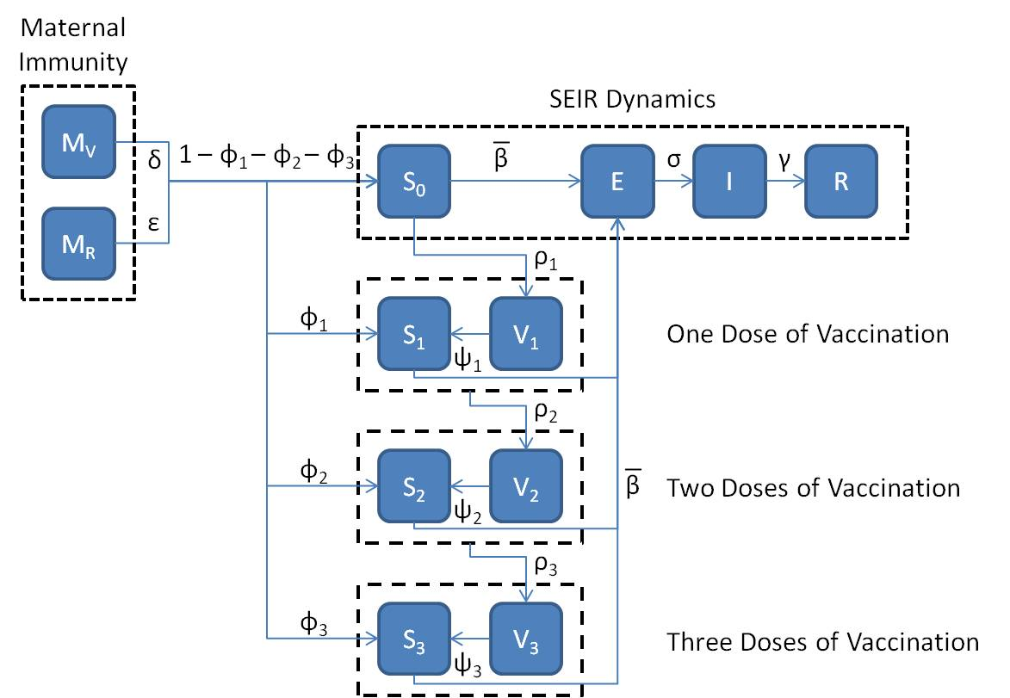

Slide 11
Vaccination Gate Function

Slide 12
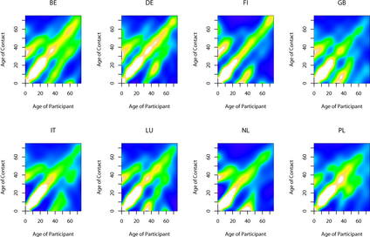
Contact matrices
Social Contacts and Mixing Patterns Relevant to the Spread of Infectious Diseases
Mossong et al. (2008)

Slide 13
Solving the model
Discretise the model. Determine discrete events and a system of ODEs
Determine the parameters
What are the initial conditions?
Solve numerically using Runge-Kutta
Analyse results

Slide 14
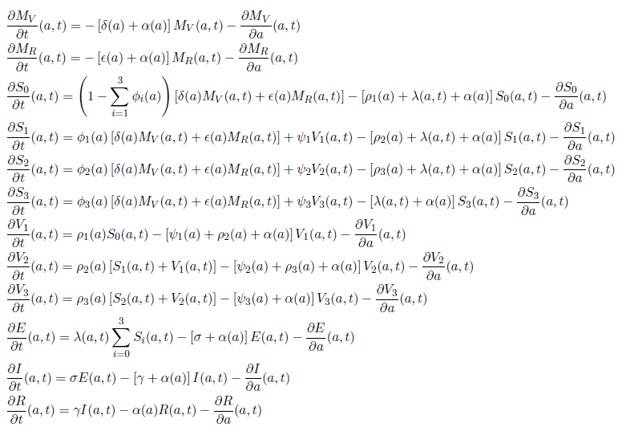
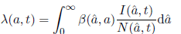
PDE Model

Slide 15
Force of Infection

Slide 16
Results – Proportion with maternal immunity 85% coverage current vaccine schedule

Slide 17
Results – Age distribution of Infection 85% Coverage current vaccination schedule

Slide 18
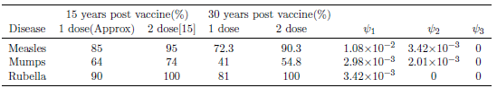
Waning Assumptions
Exponential Distribution

Slide 20
Results – Who becomes infected over these 50 years?

Slide 21
Results – Overall cost of vaccination
Without waning of vaccine derived immunity
With waning of vaccine derived immunity

Slide 22
Results – Comparing Vaccination Schemes

Slide 23
Conclusions
Potentially large number of infections in those that only received one dose of vaccine. Vaccine catch-up programme could be beneficial.
Increasing coverage can save both money and the number infections caused.
Better understanding of risk of transmission is required.
More detailed contact matrices in infants and toddlers to determine at which age initial vaccination should be administered.

